Slide 1
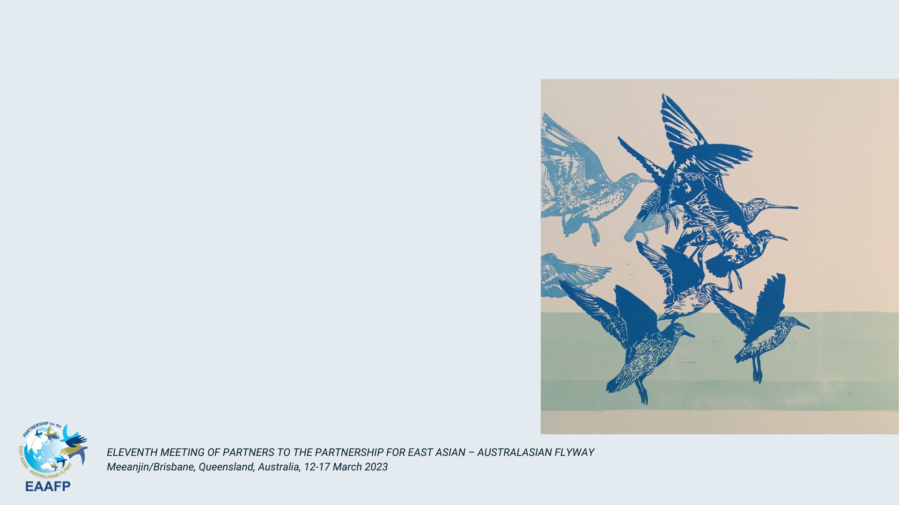
Youth Thinktank Competition Winner
Dining wetland for humans and birds
HOU Shuyu, CHEN Luyao, LI Yuhan, BU Xinchen, ZHANG Yin

Slide 2
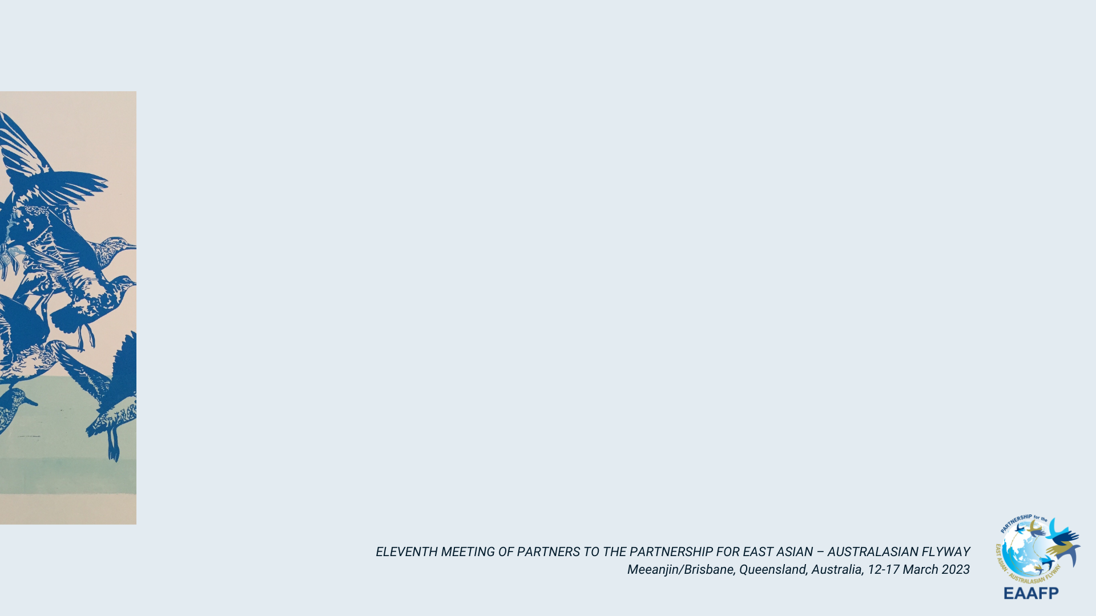
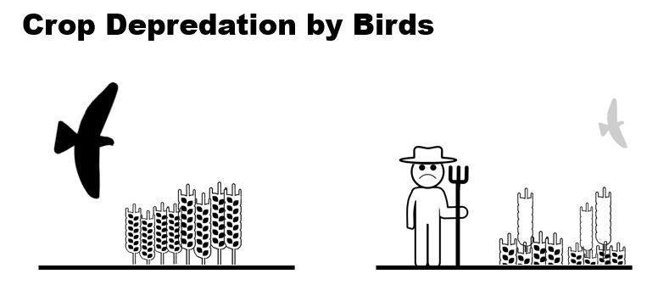
Background
Birds, our flying neighbors, are liked and inspire curiosity among citizens.
However, they can also cause problems, especially in farmland communities.
  This project focused on a modern farming site in Nanqiao county, located in the suburbs of the mega-city, Shanghai. The site is representative of urban agricultural communities, where people have a fondness for birds but also express concern about the harm they can inflict on crops.

Slide 3
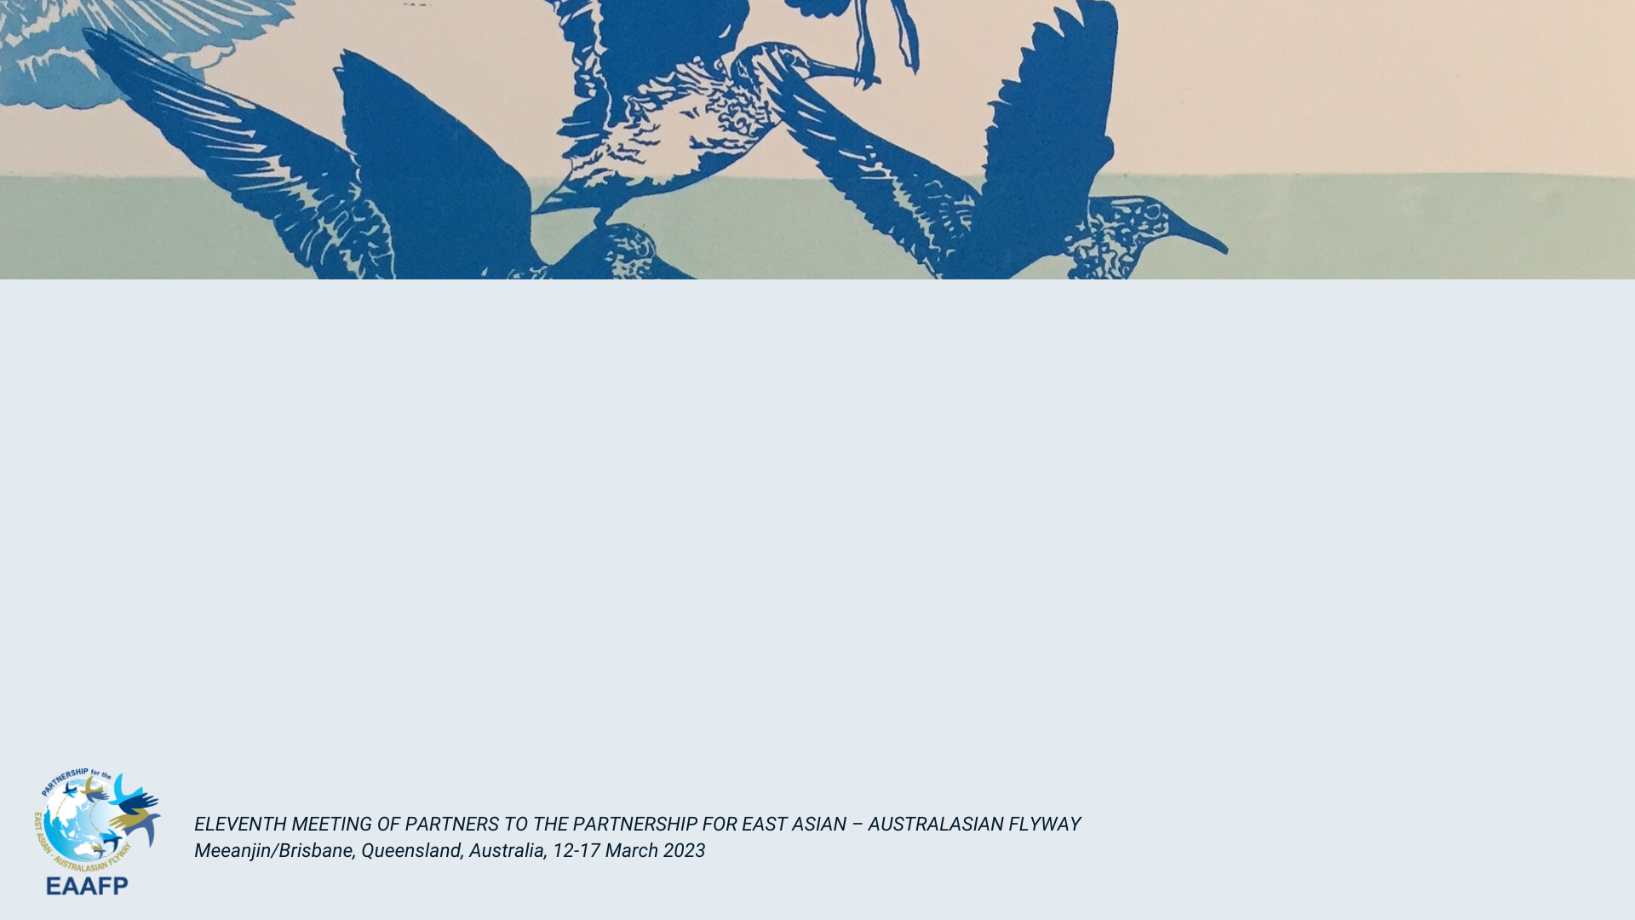
Aims & Objectives
Get to know about the biodiversity condition and community perspectives in the site
Build capacity for community and the broader public about knowledge of birds and their importance
Increase awareness and motivate action for bird conservation
Many original designed projects were severely interrupted by various reasons, but eventually the team managed to transform the offline activities to online, and received sound outcomes.

Slide 4
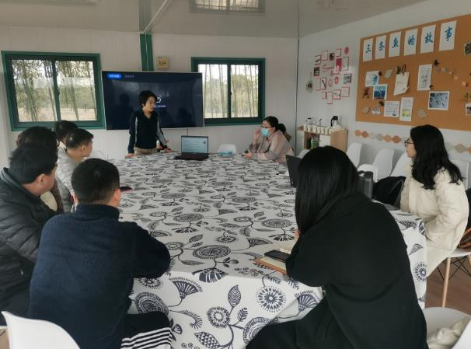
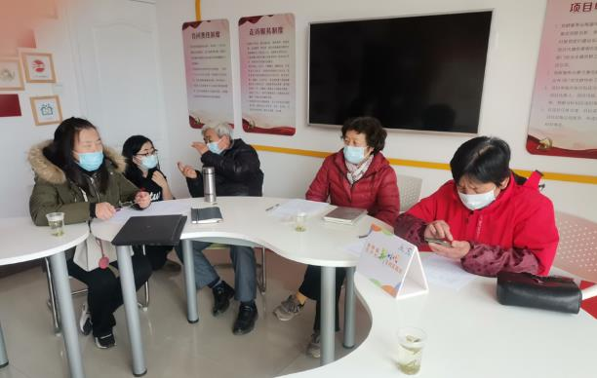
Community interview
Interviews with decision makers and stakeholders
Express project objectives
Questionnaires to understand the requirements and willingness
Participants：
Nineteen villagers in Huayan Village, including the manager of the rural cooperative, the leader of the village group, the employees of the agricultural contracting company, and ordinary villagers

Slide 5
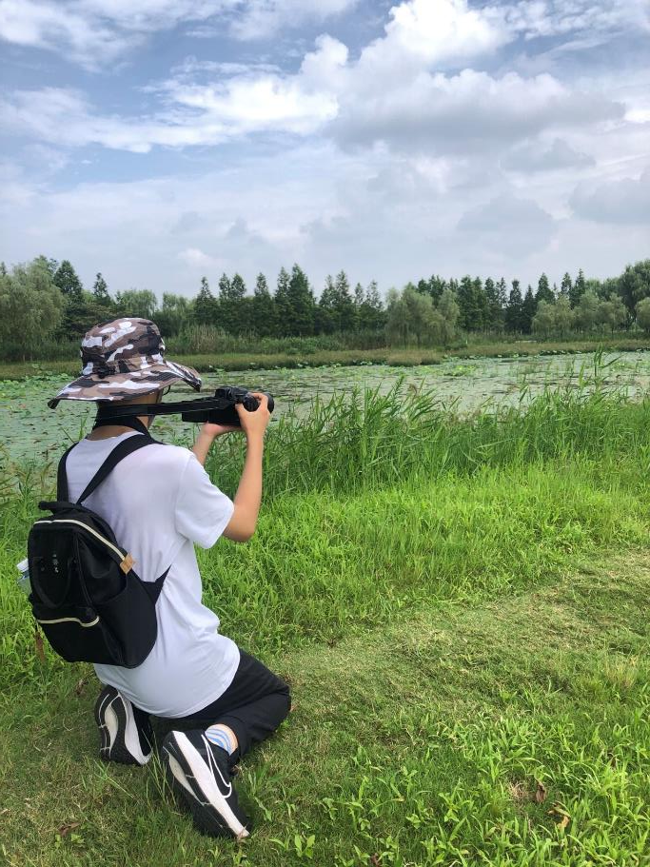
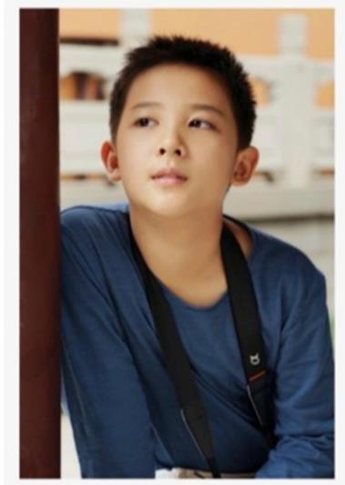
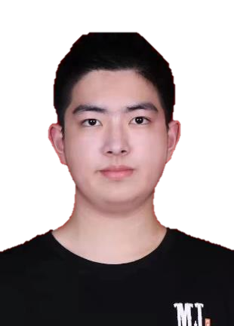
Youth’s Ideas Collection
Maybe we can try mangroves in costal areas of Shanghai to provide better habitat for the migrating birds since it’s getting warmer!
1. It is necessary to investigate the habitat of birds as well as the cultivation of agricultural products
2. Conduct a water quality survey by investigating plankton distribution status
3. We could build some artificial roosting areas in and around cropland for birds.
I think we should tell the farmers more about the bird-related knowledge and they may be more willing to protect birds
SU Yixuan,
10th Grade
ZHOU Junjie,
11th Grade
ZHANG Chenrui,
7th Grade

Slide 6

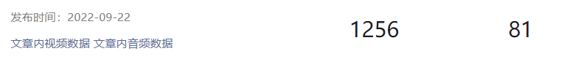
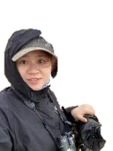

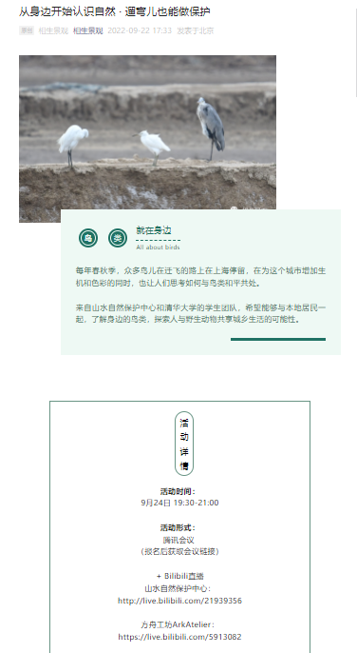
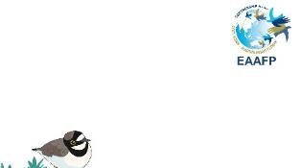
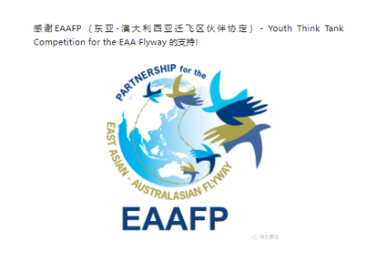

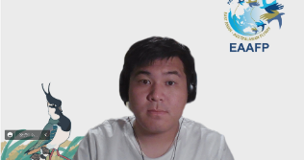

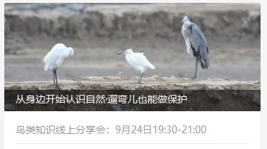
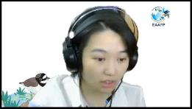

Online seminar + Multi-platform Live
Page view
Forwarded
1256
Announcement of the seminar
+
Topics:
Getting to know the natural world: starting from community.
What actions can we take for bird conservation in daily life?
+
+
+

Slide 7
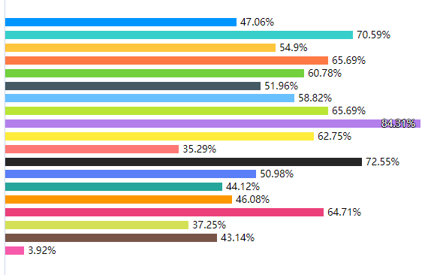
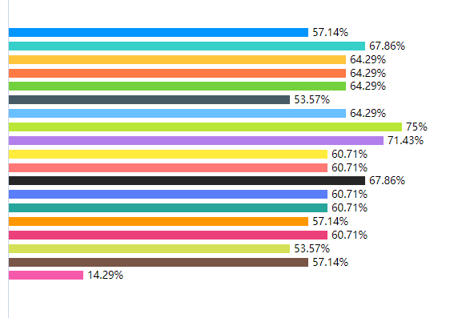
Online seminar + Multi-platform Live
We conducted online questionnaires before and after the seminar
The citizens recognized much more bird species after the seminar, and tended to have a more open mind in conservation around human settlements and cropland.
Before
After
The percentages of audience recognized the 18 testing bird species in the questionnaire

Slide 8


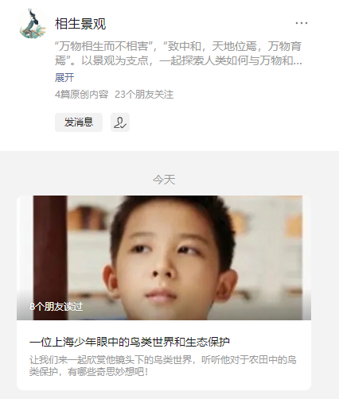
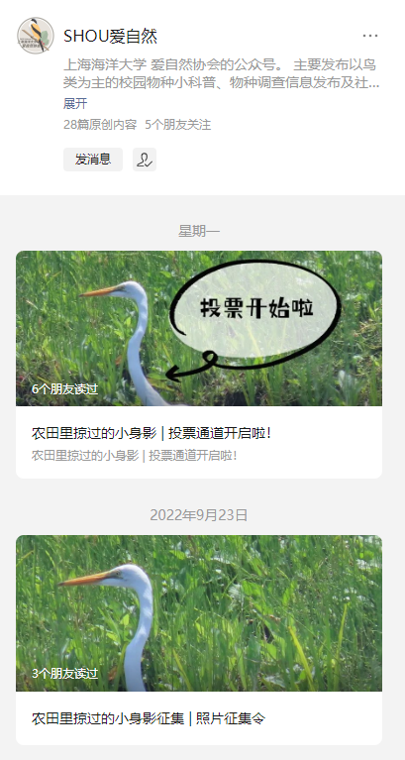
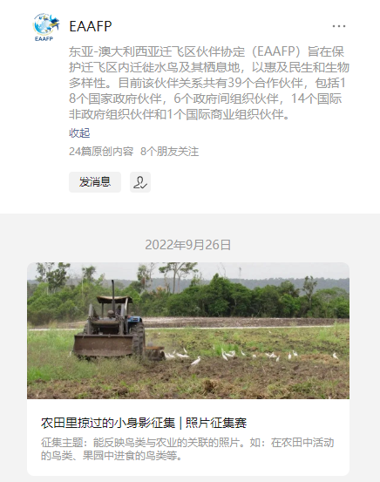
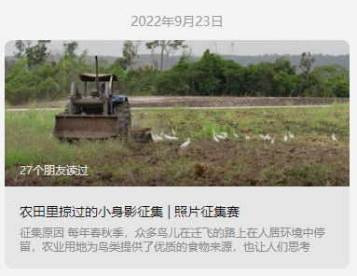
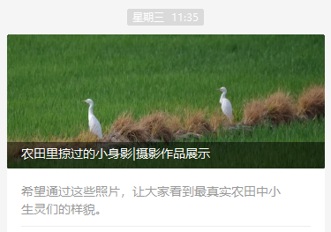
Photograph competition
3 public accounts forward our “Call for entries” article,

Slide 9
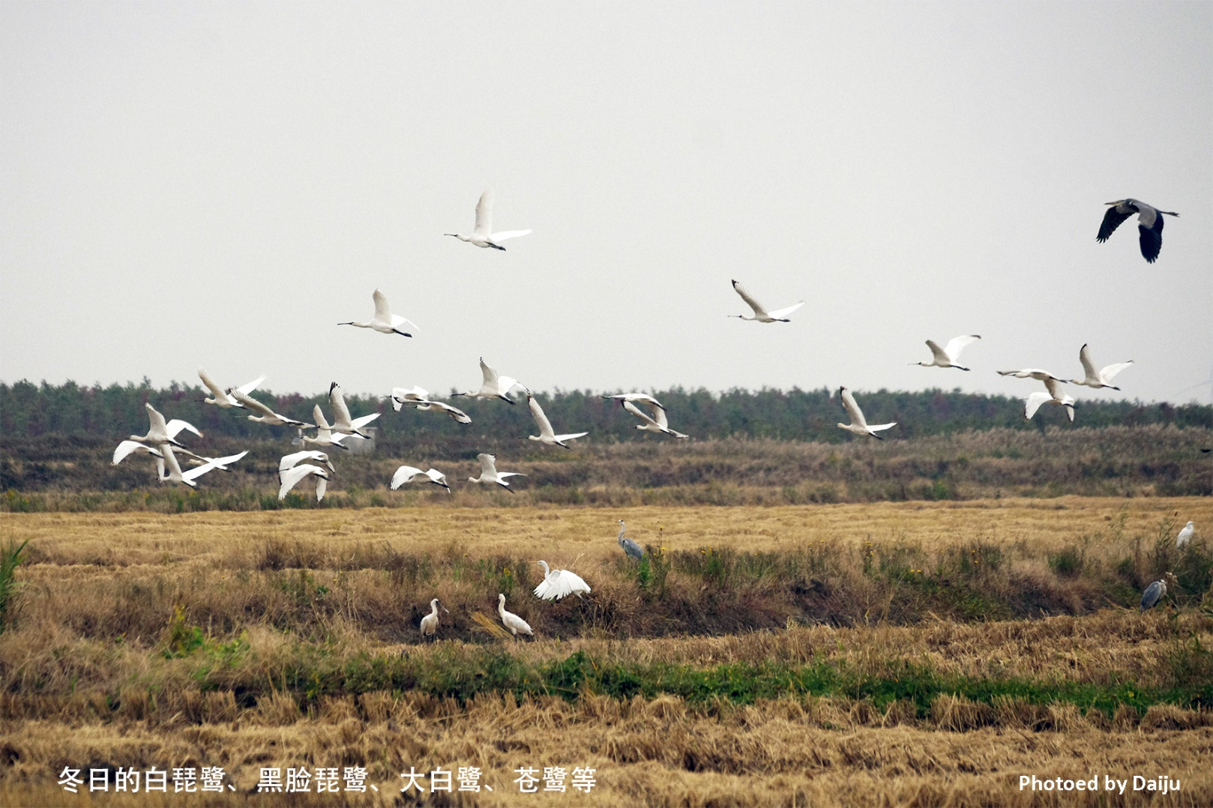
Photograph competition

Slide 10
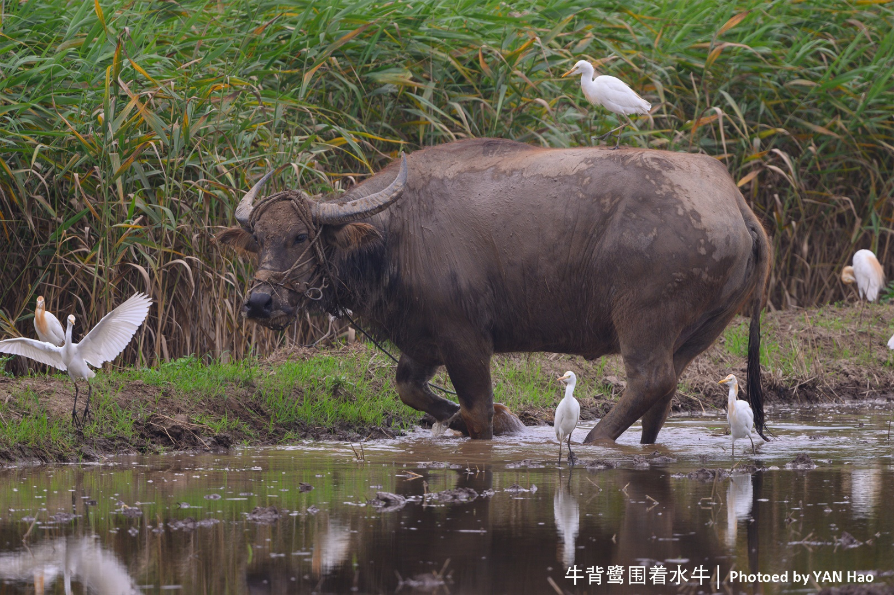
Photograph competition

Slide 11
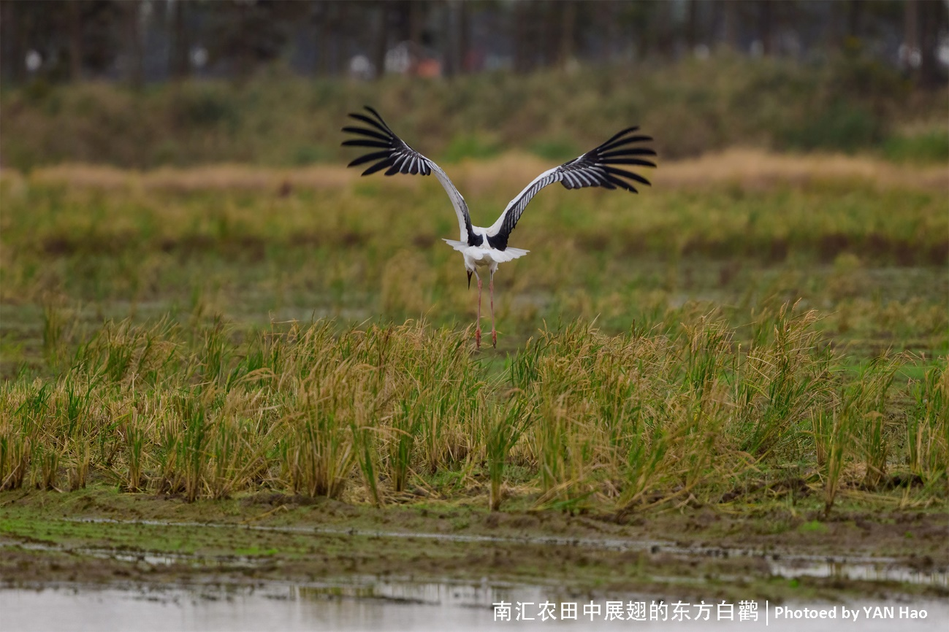
Photograph competition

Slide 12
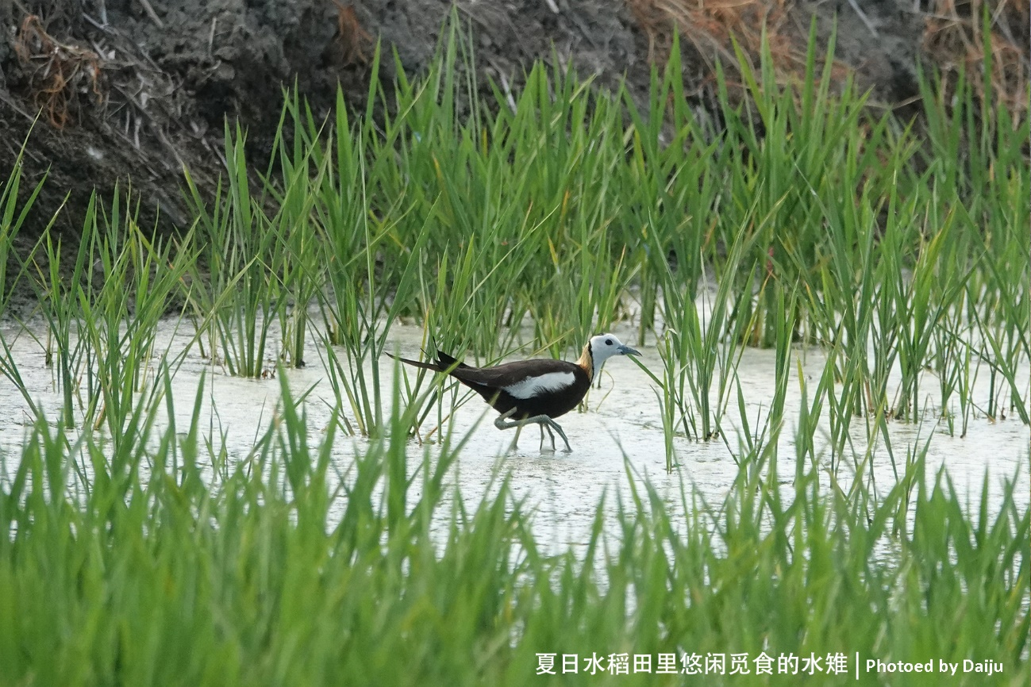
Photograph competition

Slide 13
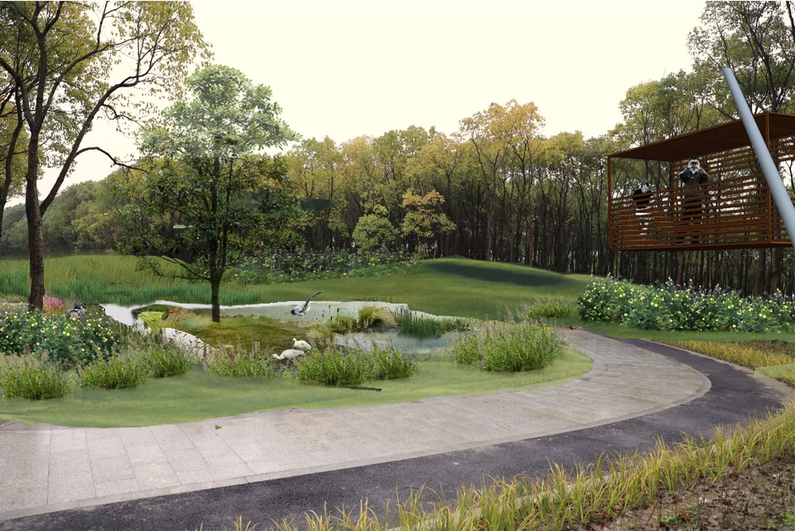
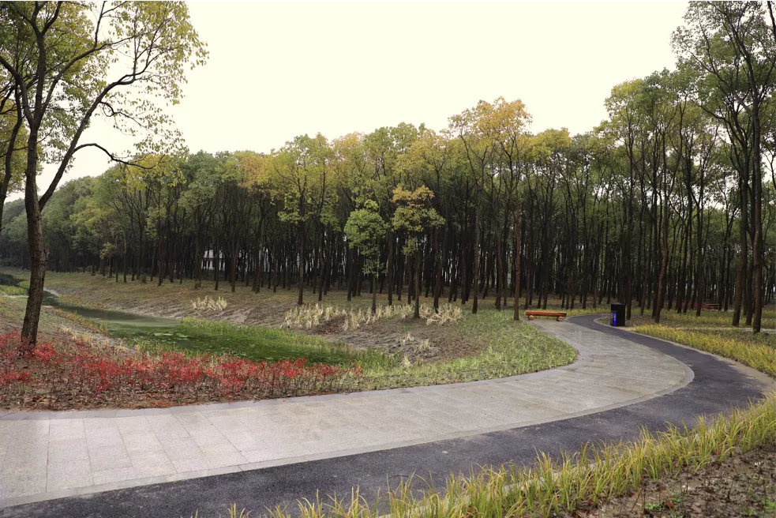
Planning and Design Suggestions
Management suggestions:
From April to June, control water level to create habitats.
From June to September, strengthened supervision that prevent using bird nets, which will be included in the village rules and regulations.
After November, keep some rice in the fields
A planning proposal for the selected site
1) Use infrastructure to minimize surface runoff;
2) Slow down the land slope;
3) Build a tree island to increase habitat provide resting and nesting sites;
4) Build a bird-watching tower

Slide 14
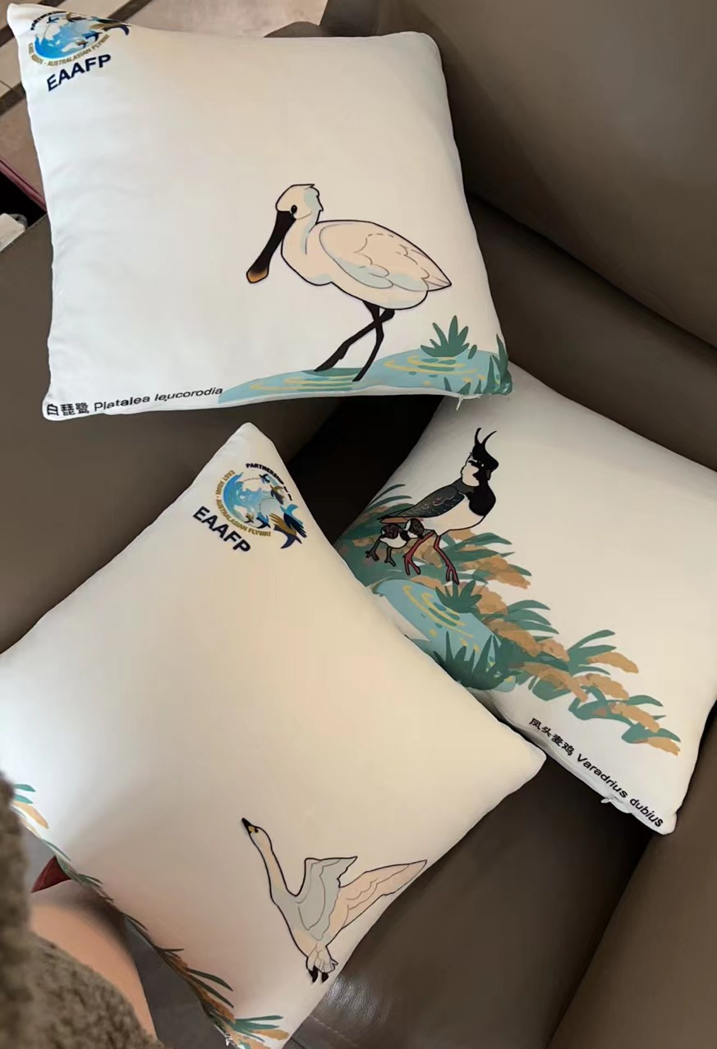
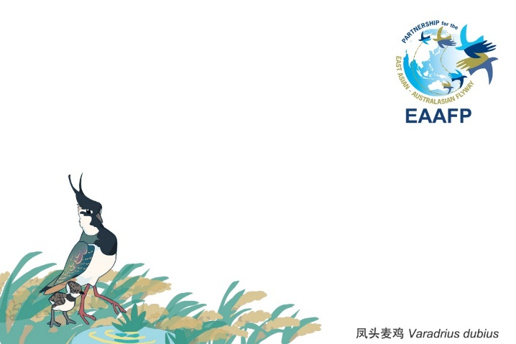
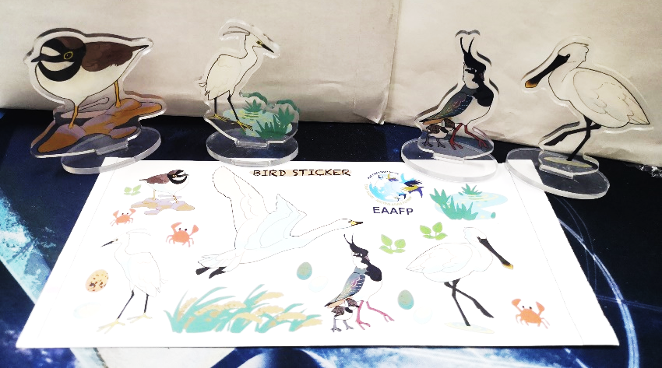
Creative products
Self-designed and produced stickers, postcards, key chains, and figures decorated with bird species of Shanghai
Increased public awareness and knowledge of bird conservation.

Slide 15
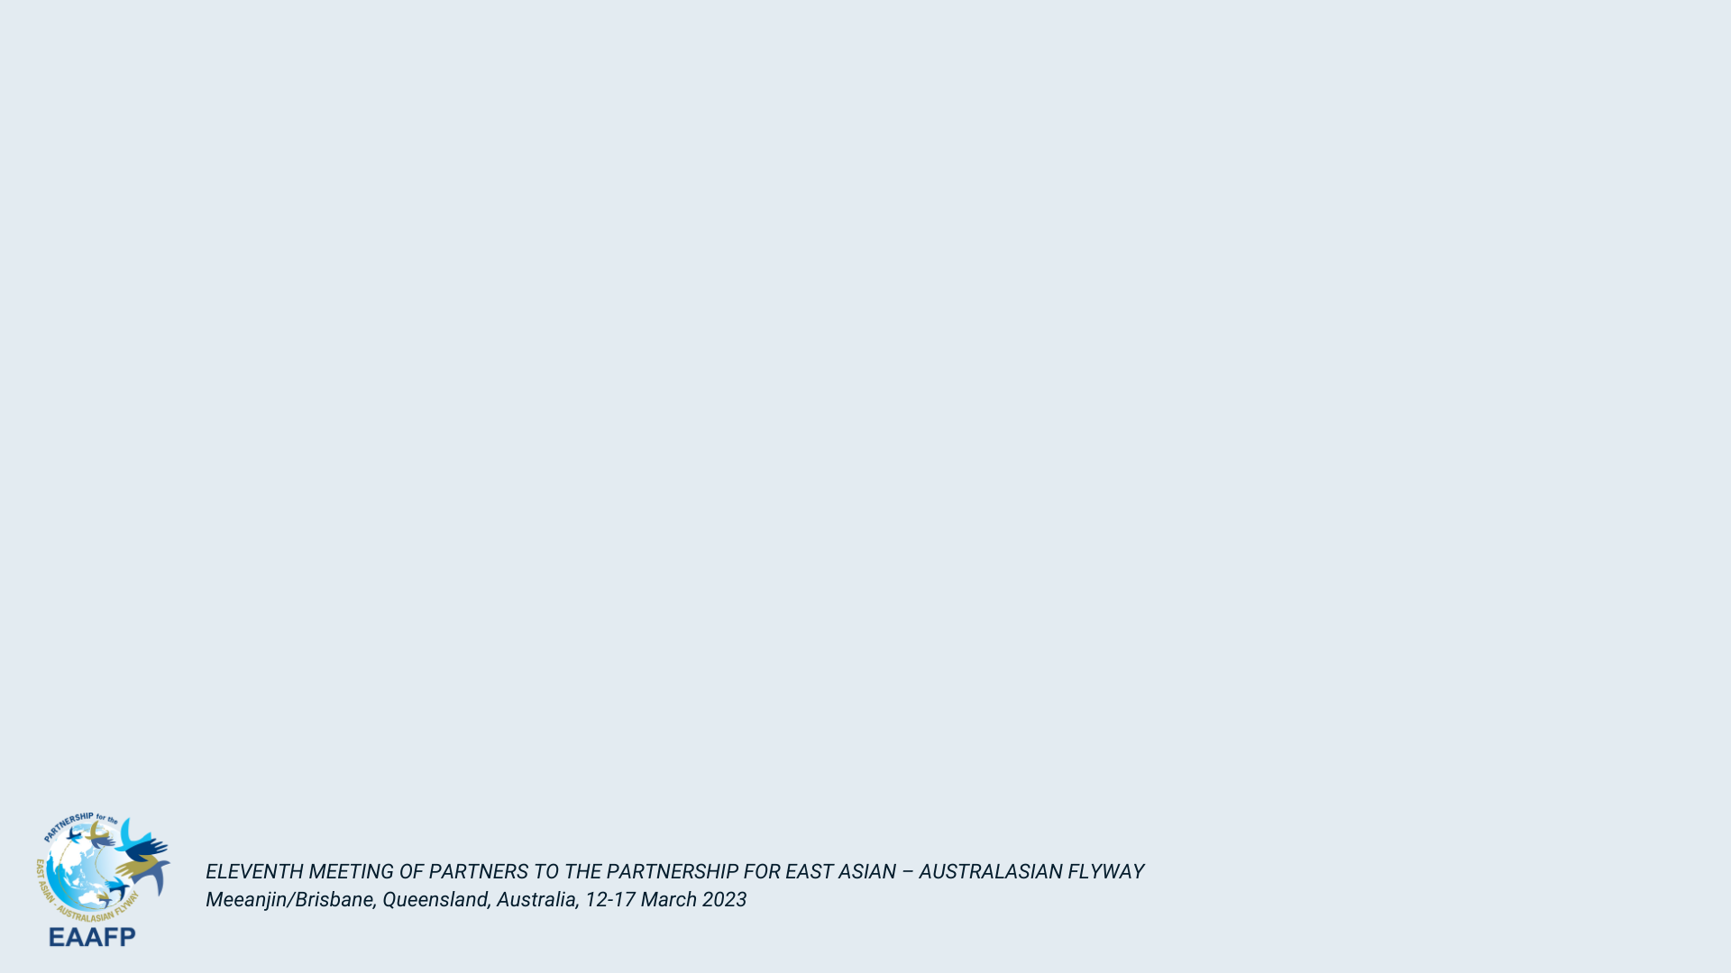
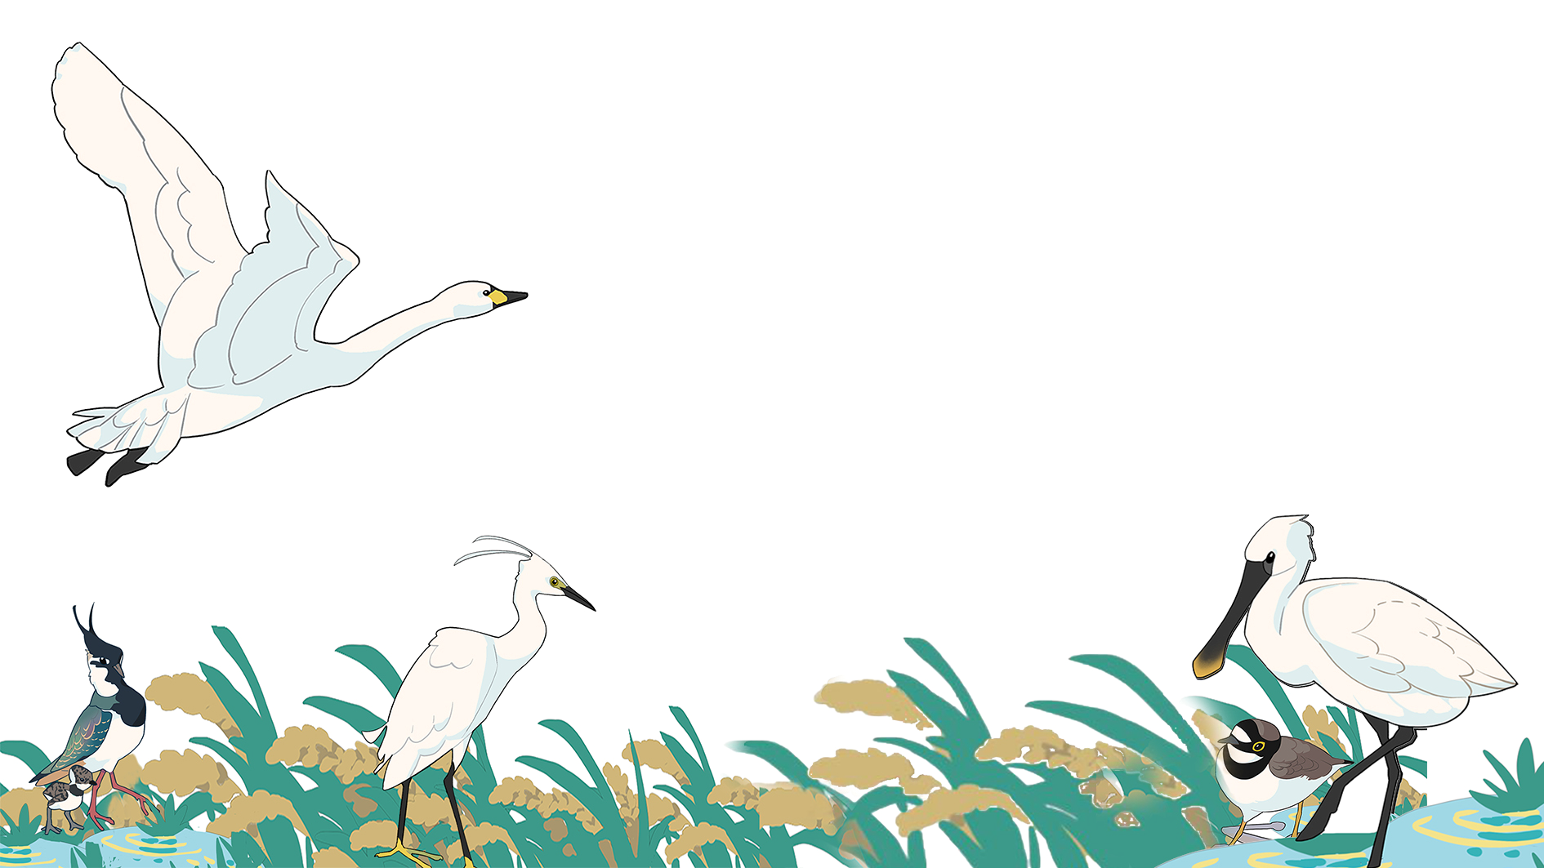
Thank you!
Shuyu Hou,
Ph.D. candidate, Tsinghua University
Email: Shuyu_Hou@outlook.com

